Slide 1
Reflectance Estimates
Jarmak, 05/26/22

Slide 2
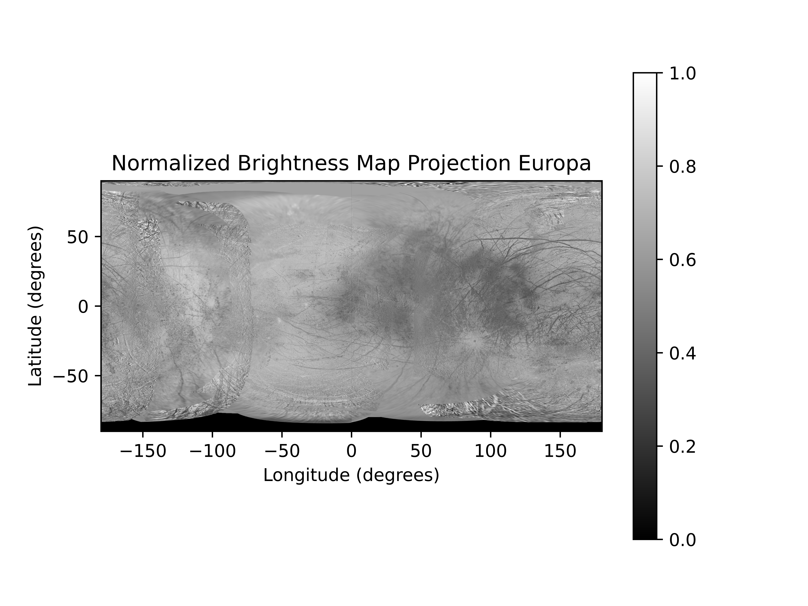
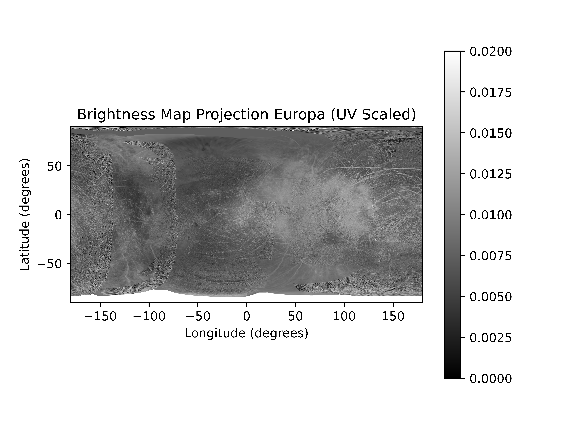
Albedo Estimate Overview
Read in cylindrical projection of Moon as a 2D image array
Normalize the pixel brightness values between 0 and 1
Invert and scale from 0 to 0.2
Albedo as function of latitude and longitude

Slide 3
Reflectance from Albedo
Assuming Lambertian symmetry: Albedo / pi (no geometric input)
Geometry dependencies include phase angle, incidence angle, emission angle
In order from highest fidelity and complexity to least complexity:
Polynomial model (global photometric model scaled by albedo as function of lat/lon), Hapke model, Lommel-Seeliger plus Lambert, Minnaert
Reflectance function will take the form,
Reflectance(latitude, longitude, emission, incidence, phase, moon)

Slide 4
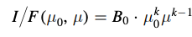
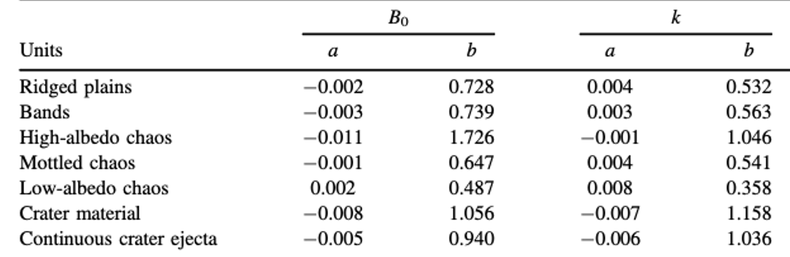
Simplest that includes geometry: Minnaert
B0 = albedo (for a lunar photometric function is geometric albedo)
Mu0 = cos(incidence angle)
Mu = cos(emission angle)
k fit photometric parameter dependent on solar phase angle
Lambert surface has k = 1, low-albedo surface with Lomel-Seeliger scattering law has k ~ 0.5
Fit photometric parameters for Europa from Dhingra et al. 2021
Model returns fit parameters for k and B0 as functions of phase angle
https://doi.org/10.3847/PSJ/ac06d6
Notes:
If we have an estimation of the albedo has a function of lat/lon maybe we can replace the B0 parameter with this albedo to get the reflectance as a function of lat, lon, emission angle, incidence angle and phase angle given that k is a fit photometric parameter dependent on the solar phase angle (instead of choosing a fixed value for k)

Slide 5
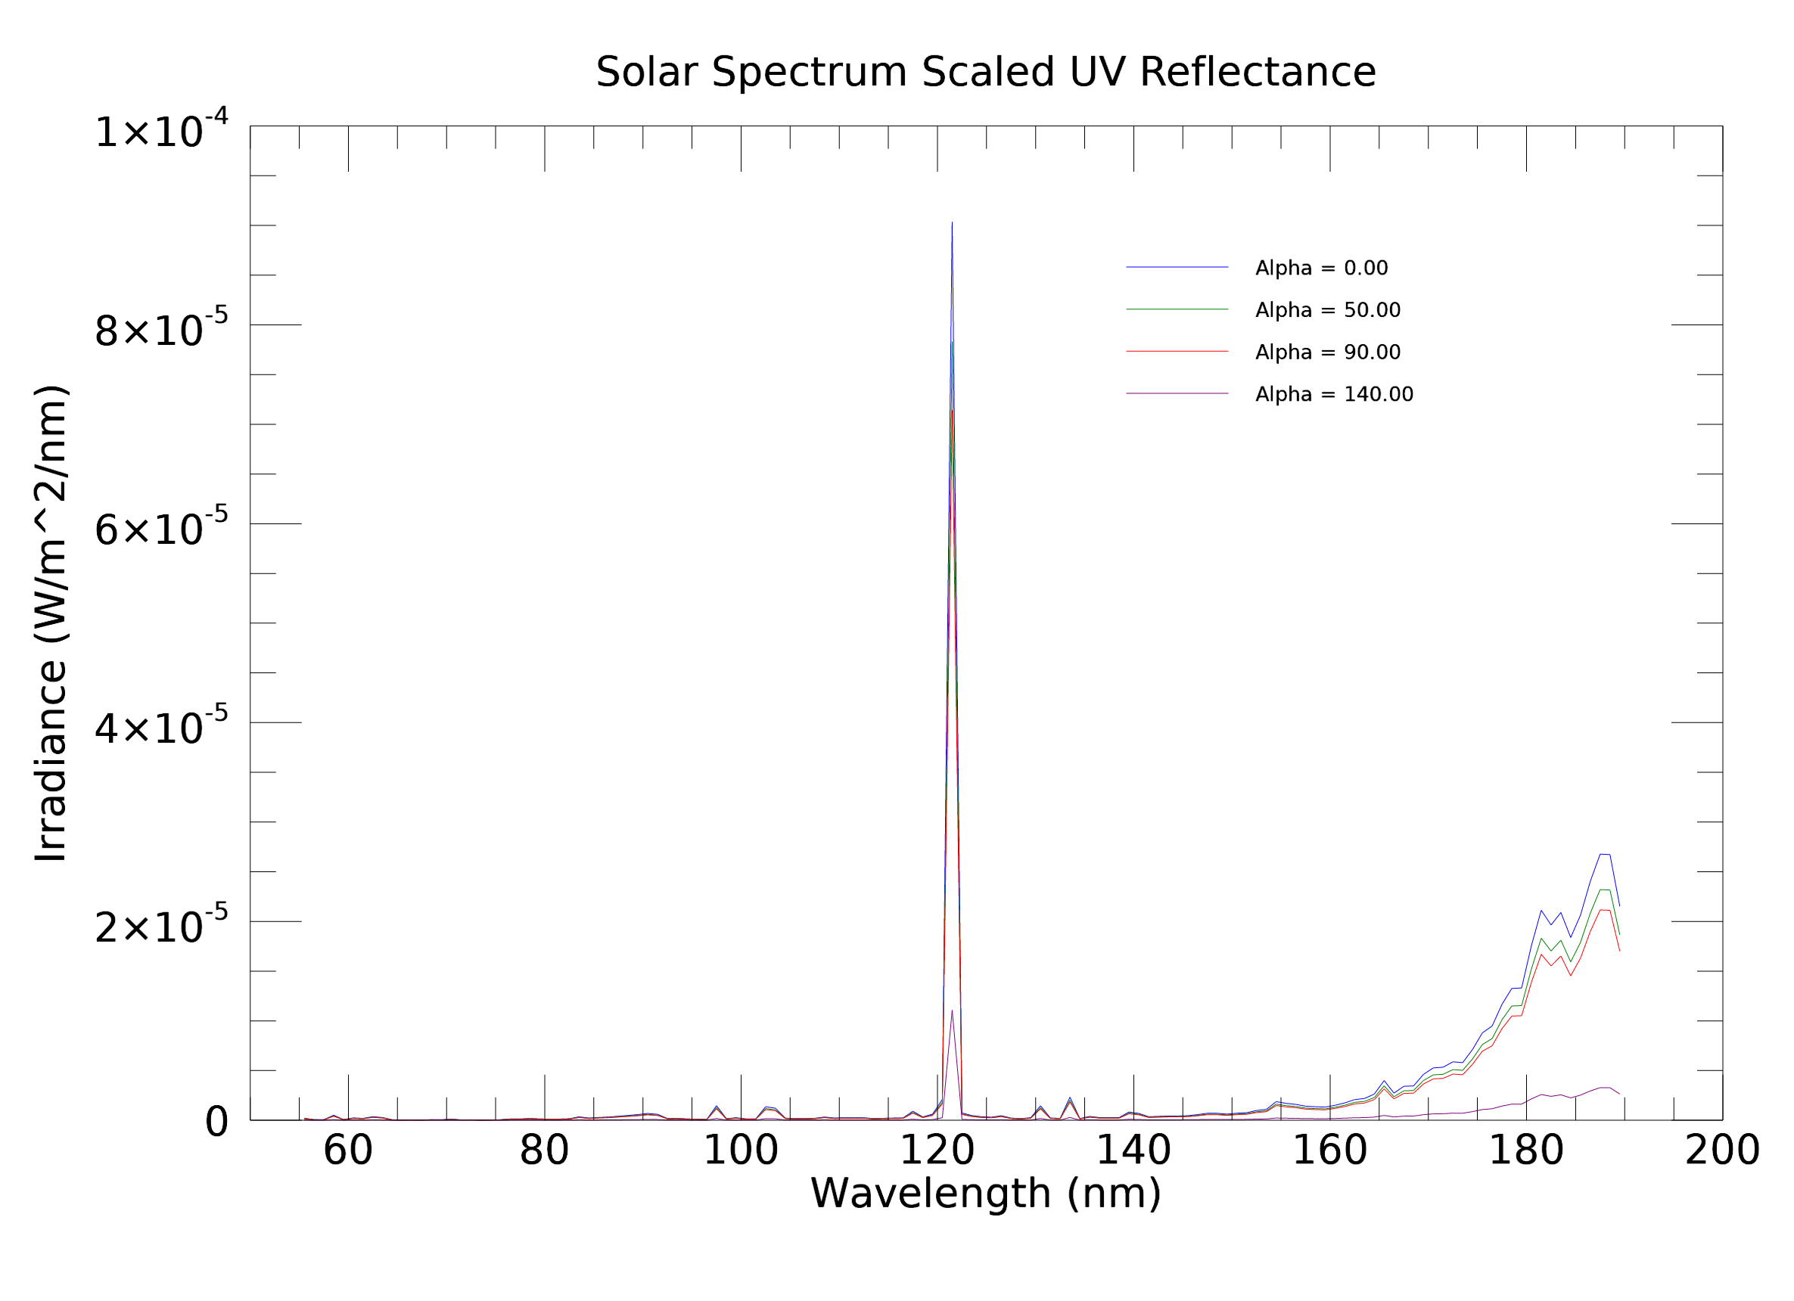
Scaling Reflectance to UV
Algorithm
Scale normalized albedo map to min max values of B0 (0.487, 1.726)
Use lat, lon to find scaled albedo value
Find index of list of calculated B0 values for the given phase angle that is closest to the scaled albedo value at the lat, lon
Use that index to select the appropriate equation for k (i.e. in same corresponding geologic region as was found for B0)
Replace B0 in model with scaled UV albedo, use calculated value of k for given phase angle, calculate remaining photometric terms using incidence and emission angles to get UV reflectance
Scale solar spectrum by this UV reflectance, output checks for various values of alpha (as expected, reflectance decreases with increasing phase angle)

Slide 6
Albedo Map Sources
Source for maps: NASA PDS, USGS.gov
Europa: https://astrogeology.usgs.gov/search/map/Europa/Voyager-Galileo/Europa_Voyager_GalileoSSI_global_mosaic_500m
Ganymede: https://astrogeology.usgs.gov/search/map/Ganymede/Voyager-Galileo/Ganymede_Voyager_GalileoSSI_Global_ClrMosaic_1435m
Callisto: https://astrogeology.usgs.gov/search/map/Callisto/Voyager-Galileo/Callisto_Voyager_GalileoSSI_global_mosaic_1km
Io: https://astrogeology.usgs.gov/search/map/Io/Voyager-Galileo/Io_GalileoSSI-Voyager_Global_Mosaic_ClrMerge_1km

Slide 7
Europa Map (Vis/UV)

Slide 8
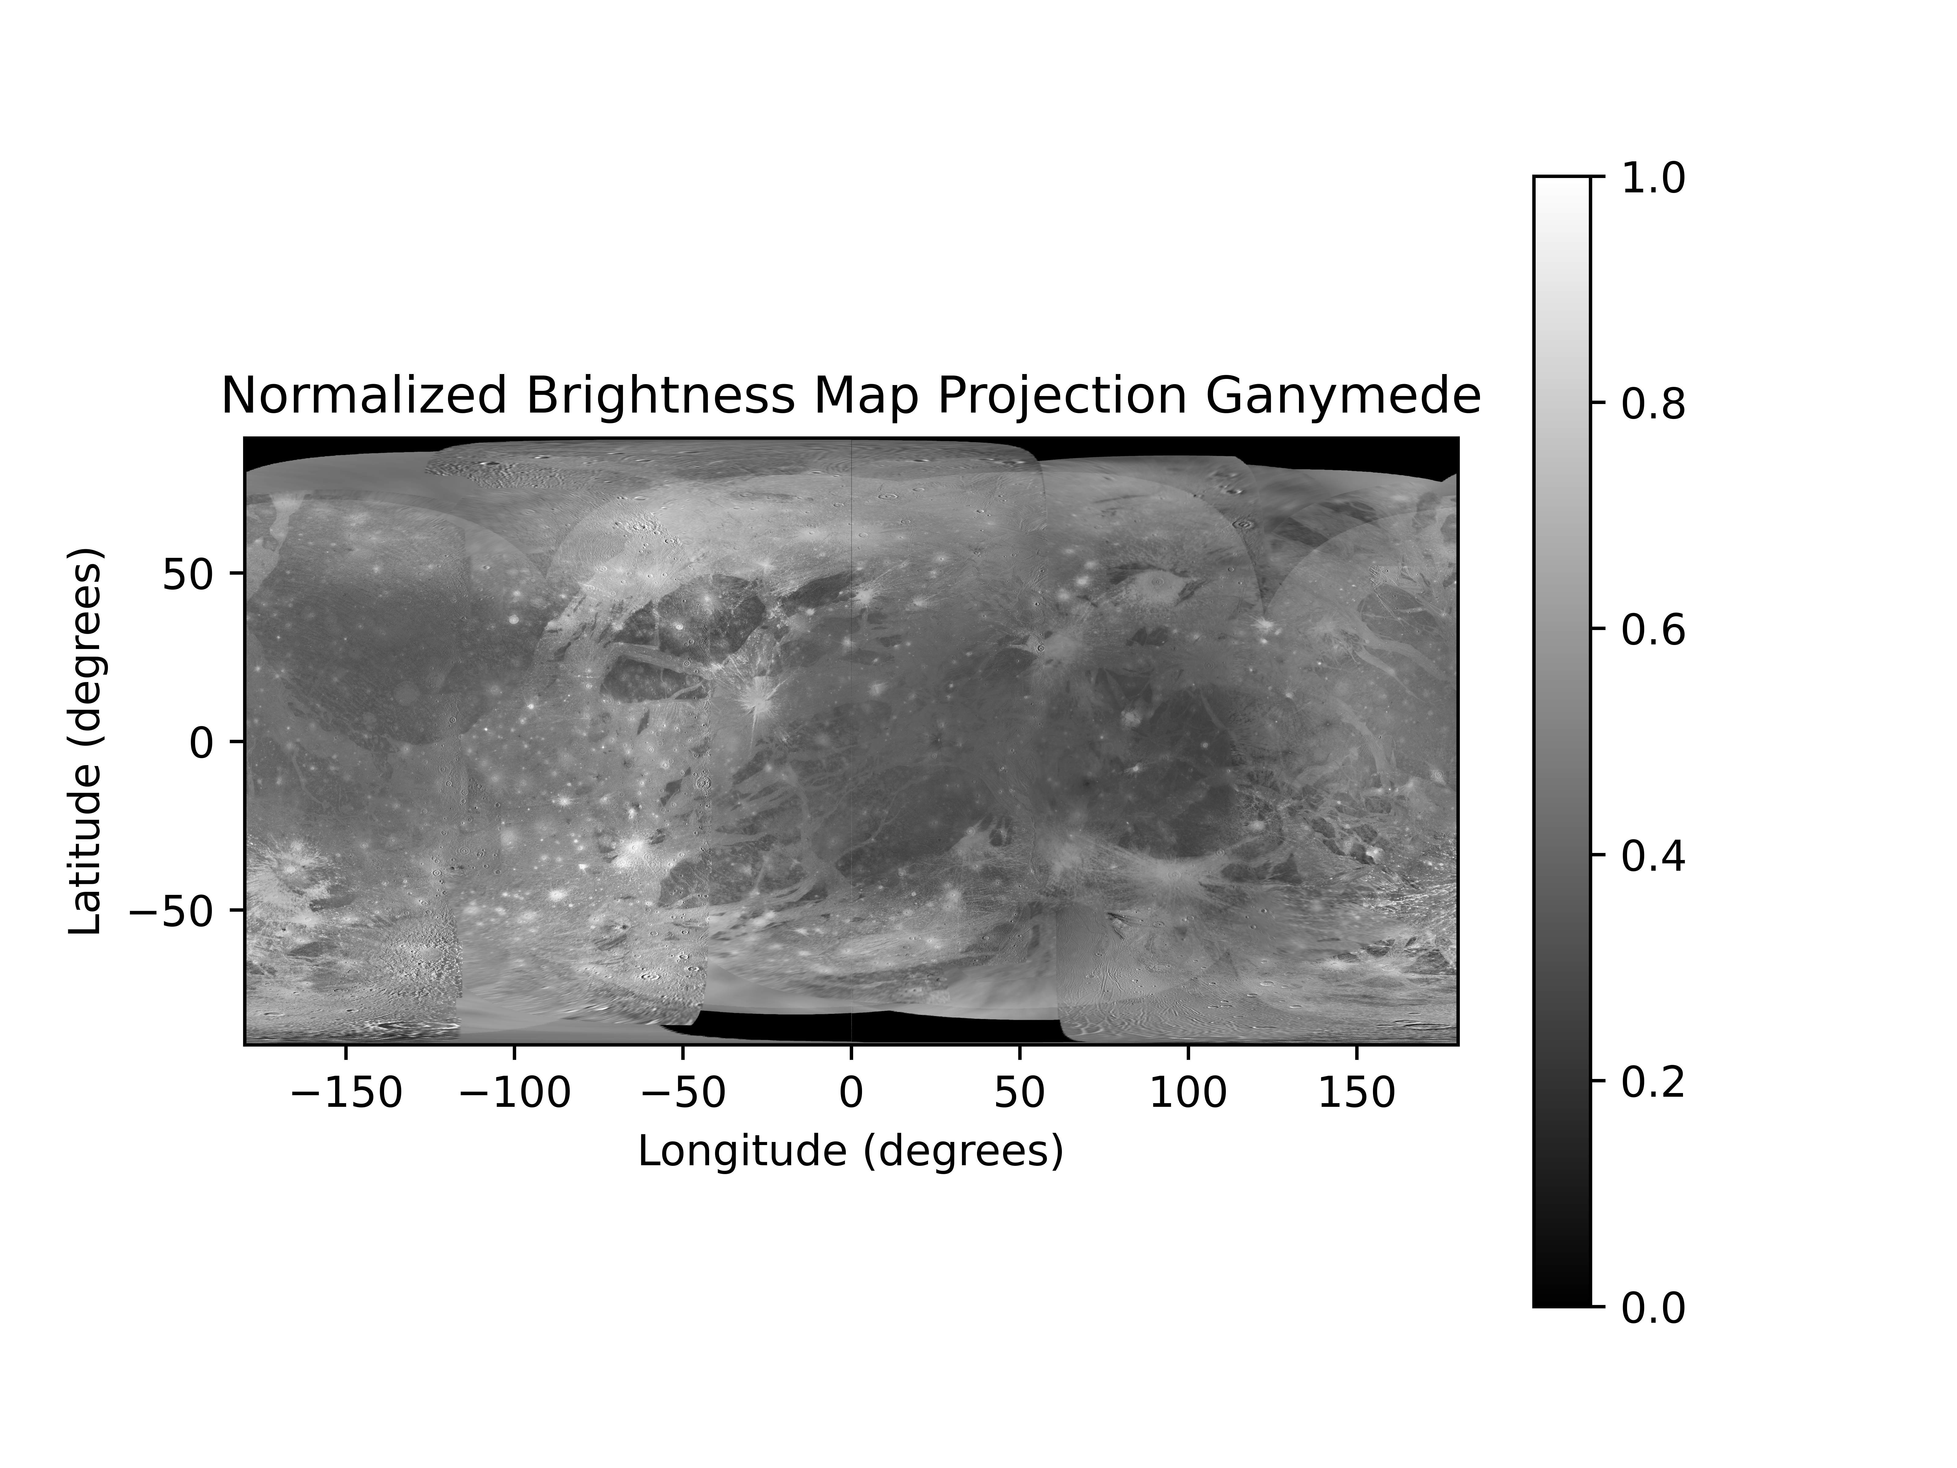
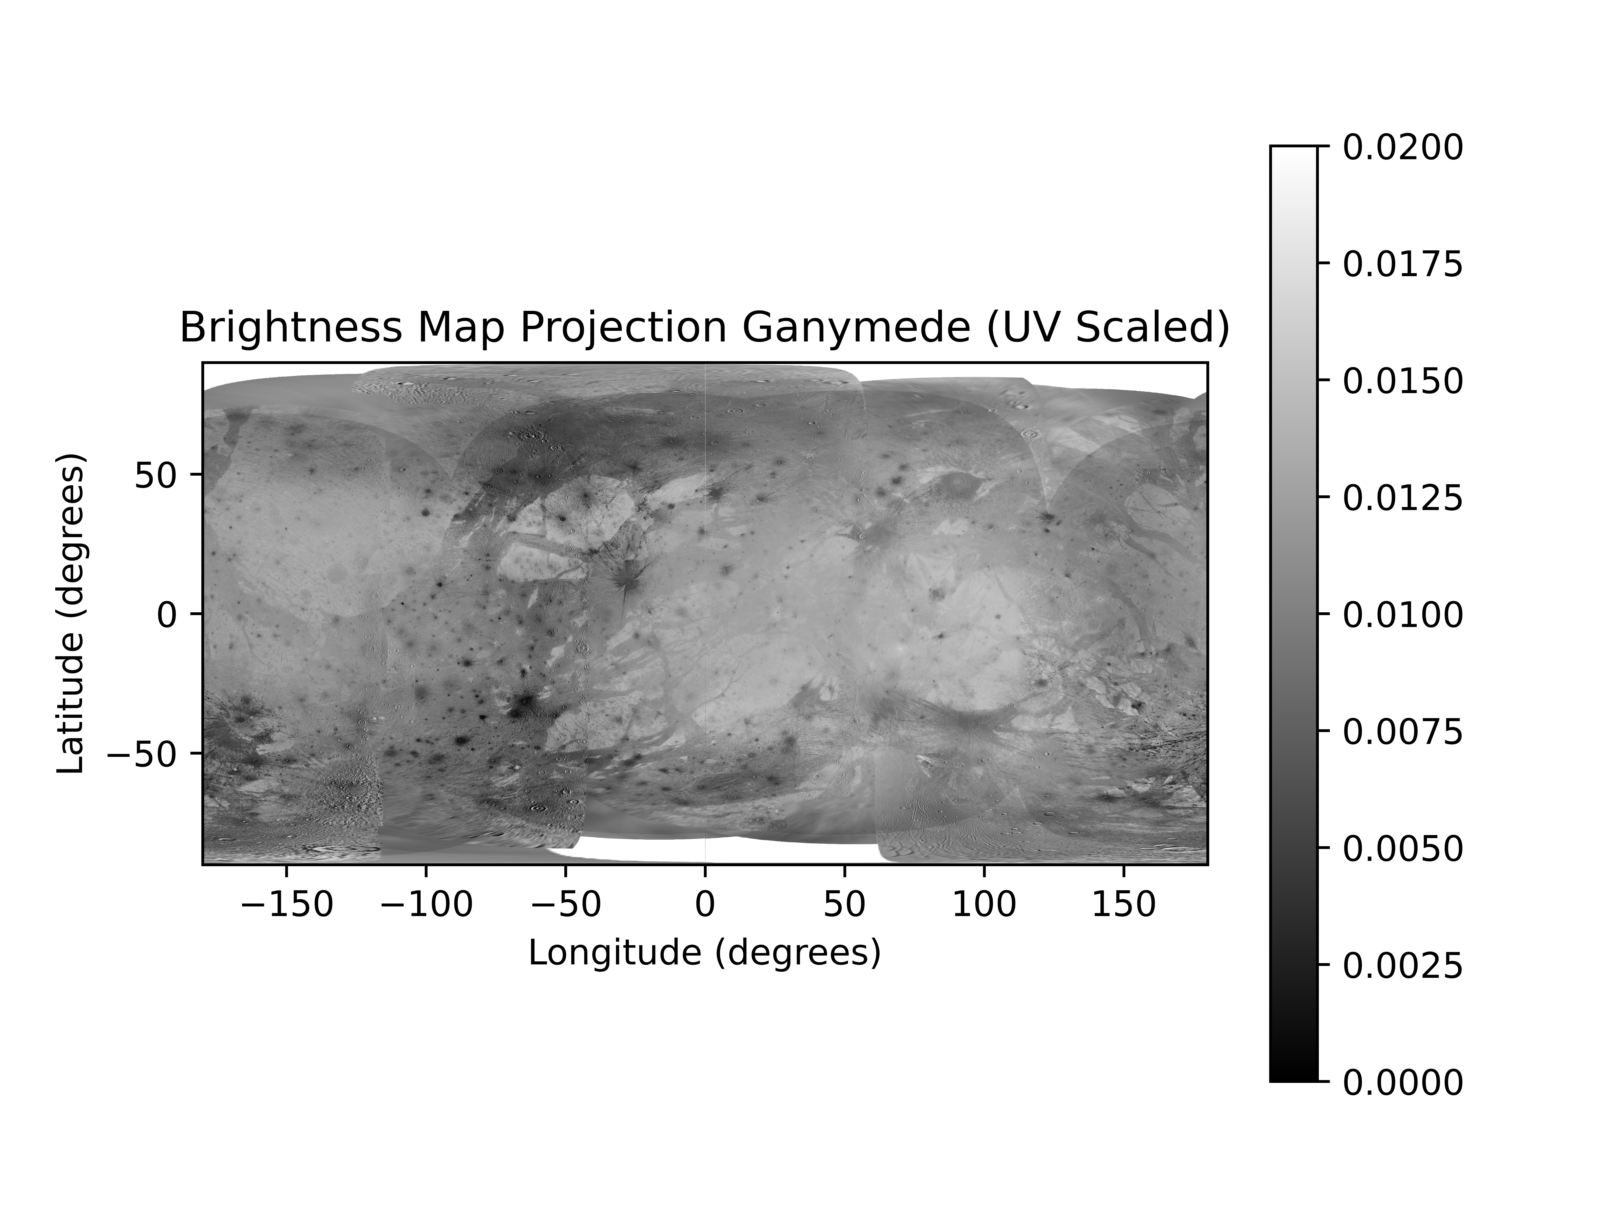
Ganymede Map (Vis/UV)

Slide 9
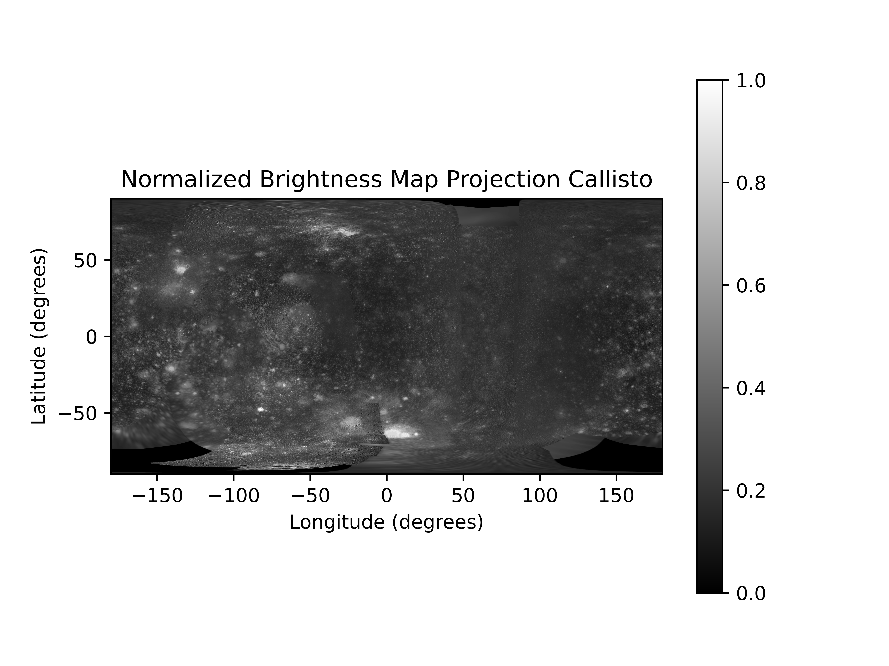
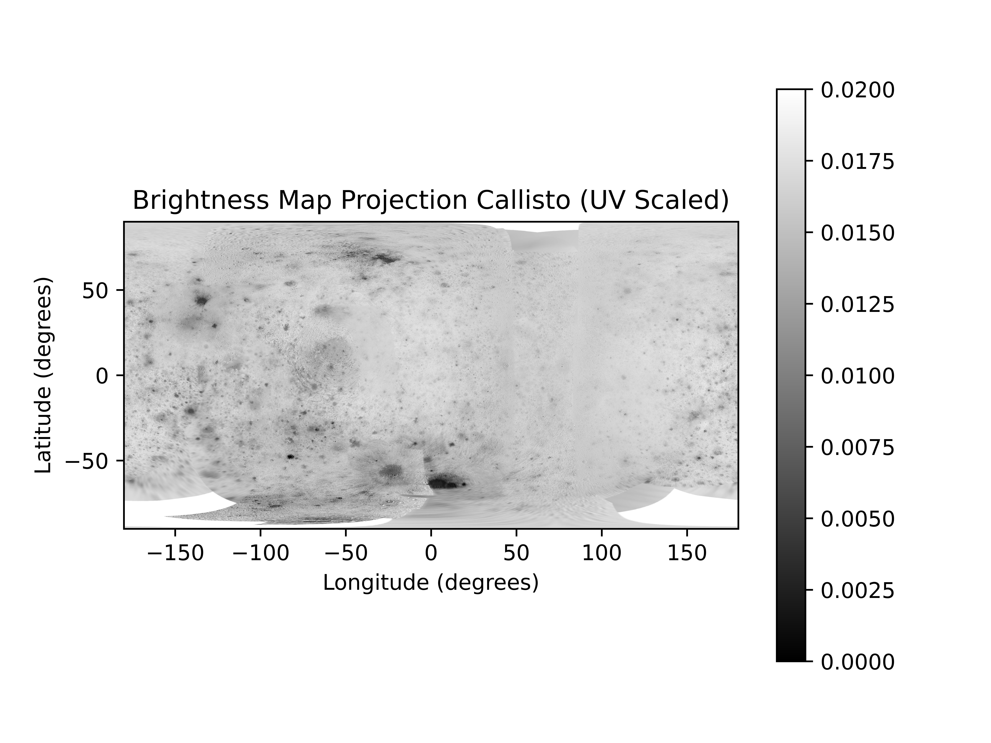
Callisto Map (Vis/UV)

Slide 10
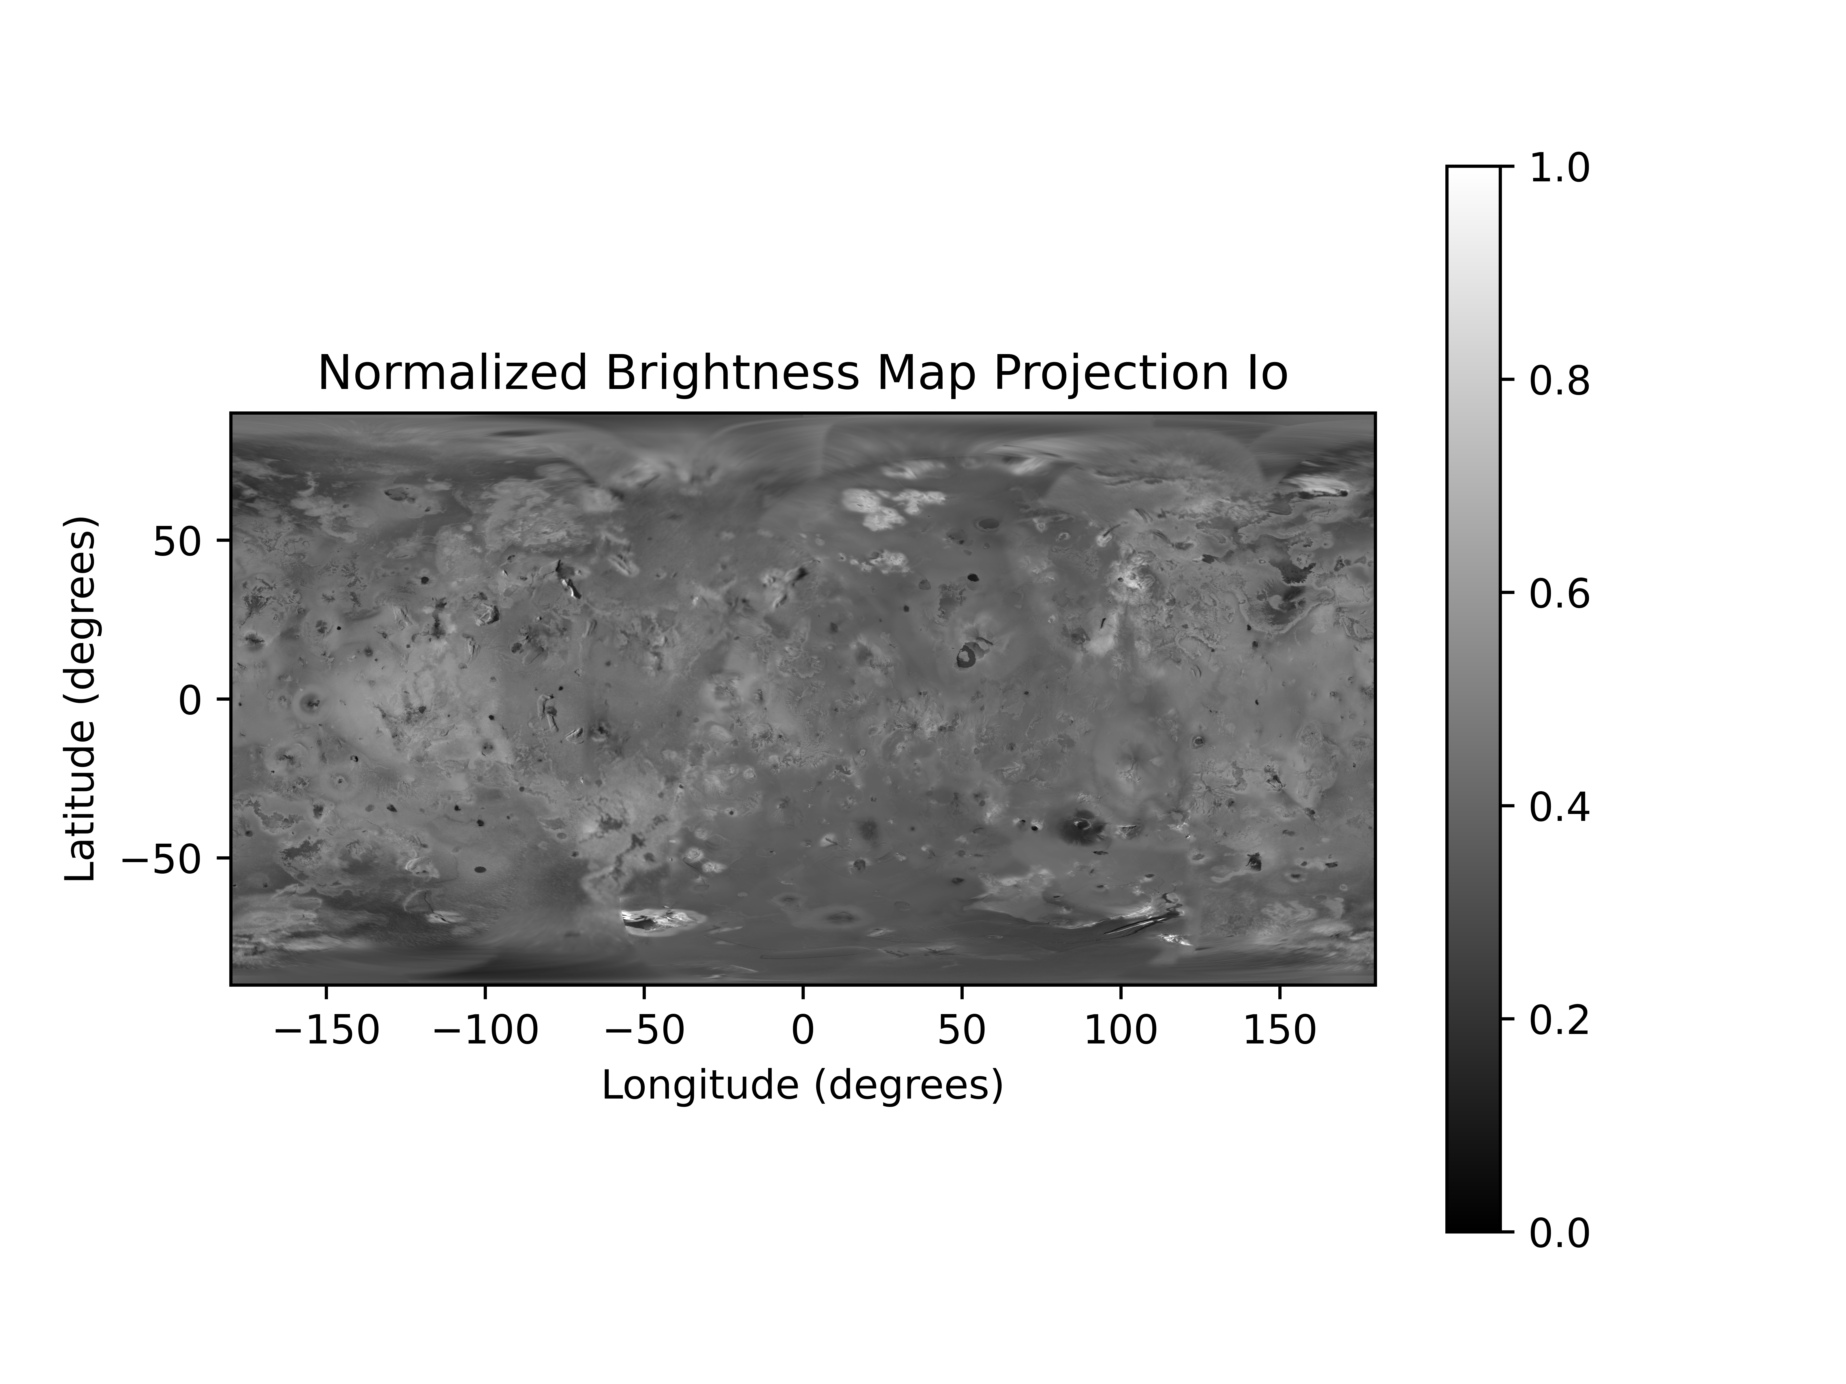
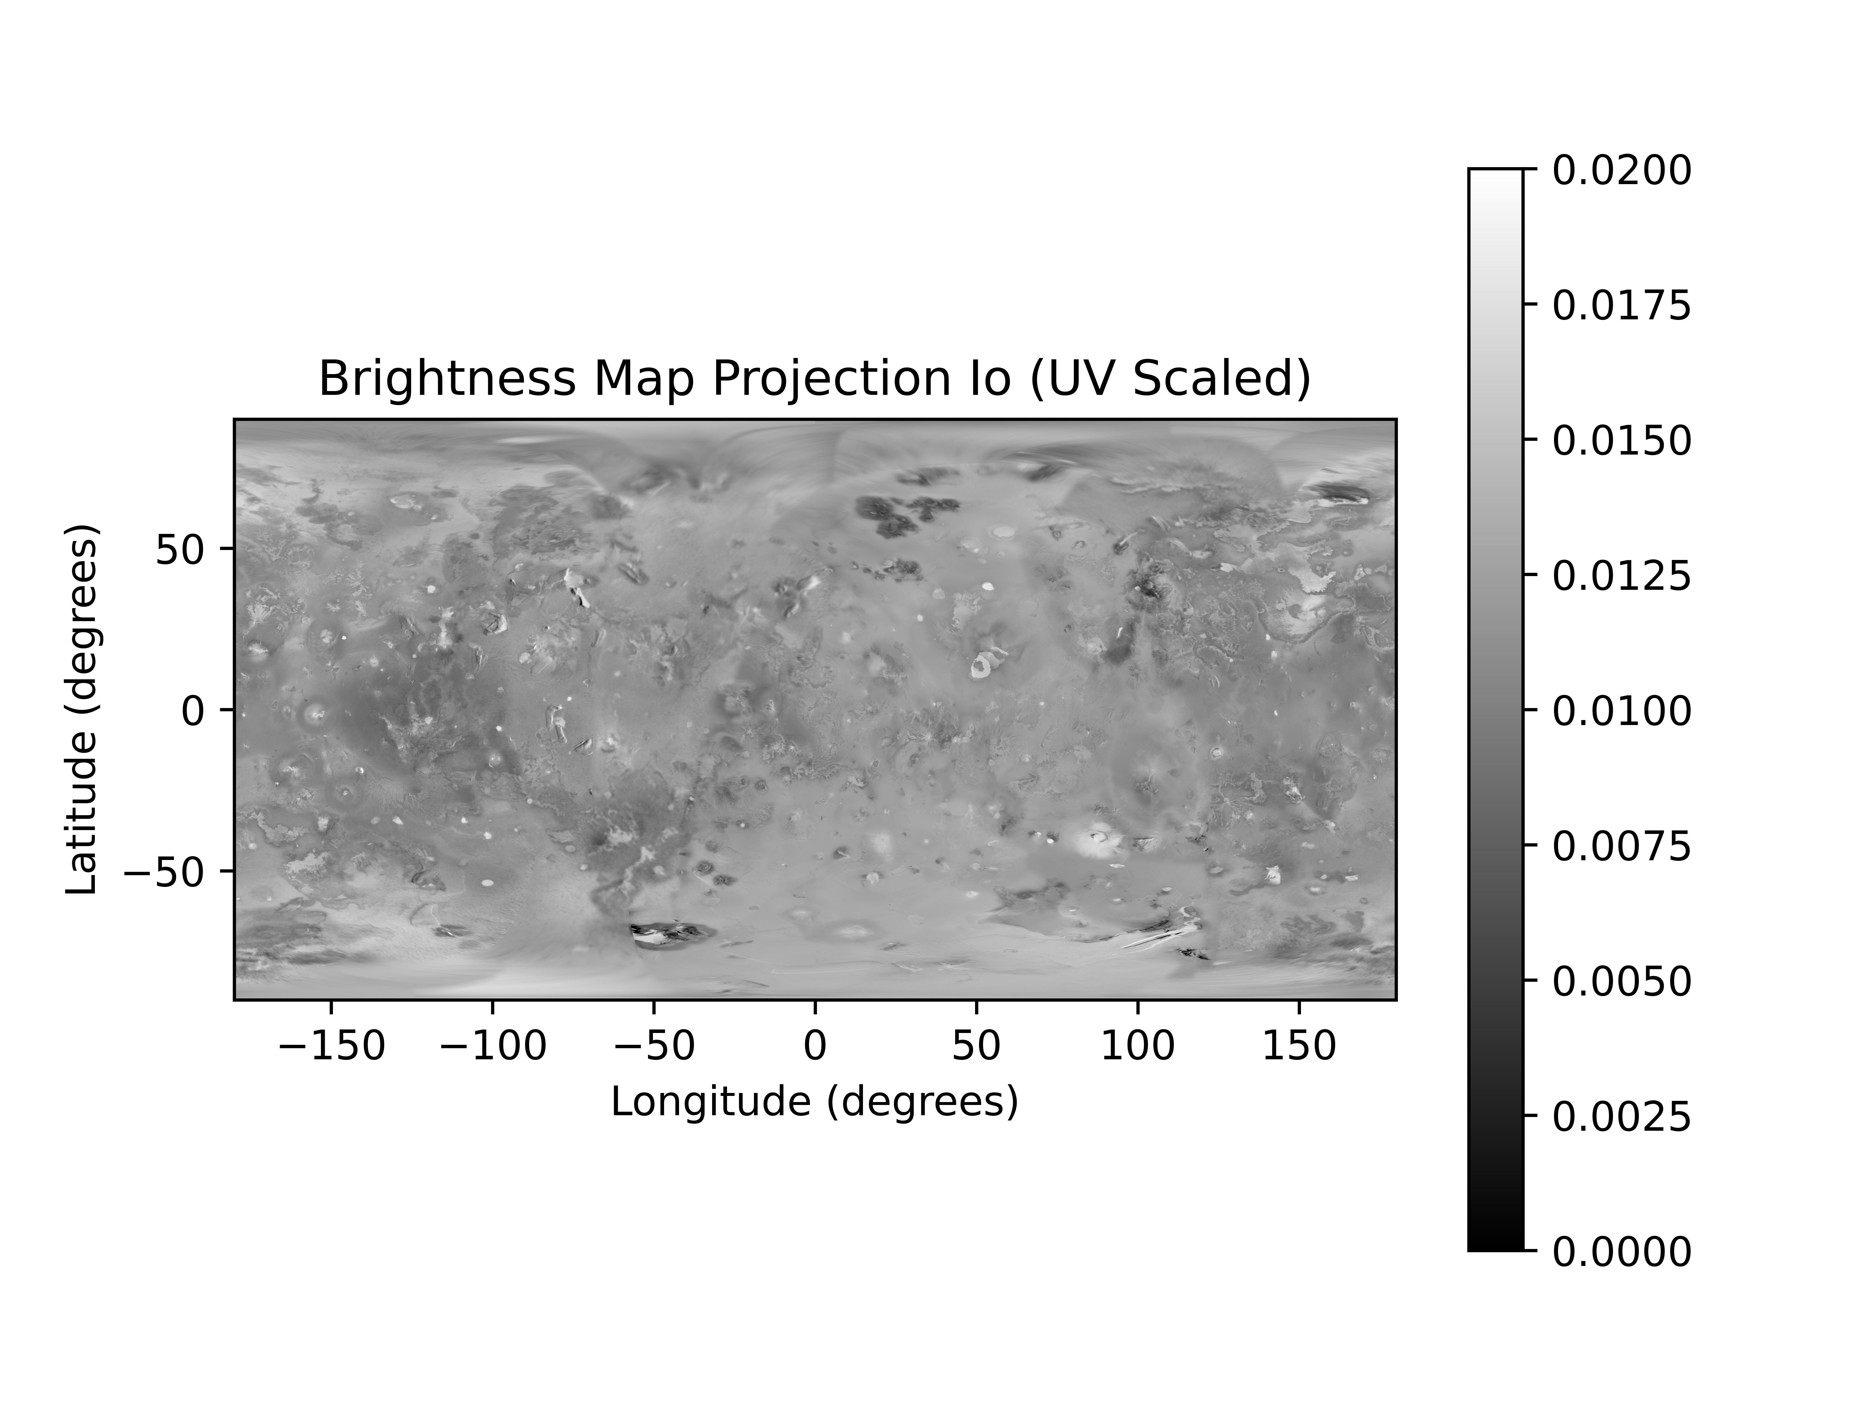
Io Map (Vis/UV)

Slide 11
More complicated models…
The global photometric model in the works by Belgacem et al. 2021 is probably the highest fidelity option for Europa, but this group is still working on producing the global photometric model and it may be more relevant for the data analysis interpretation phase as opposed to observation planning phase where a less robust option would still be sufficient

Slide 12
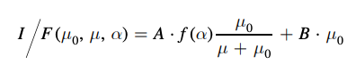
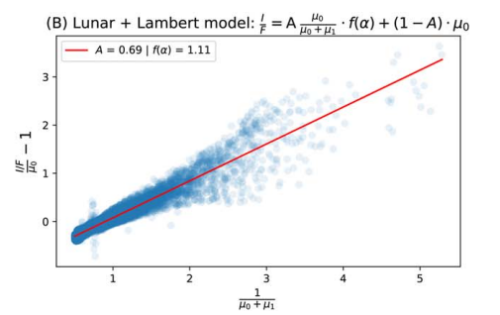
Lommel-Seeliger + Lambert Model
Issue with this approach is that f(alpha) encodes the albedo information so it isn’t
trivial to just add in a UV scaled albedo factor
Normalization constraint: B = 1 – A
Mu0 = cos(incidence angle)
Mu = cos(emission angle)
A and B parameters dependent on multiple scattering surface amount, f(alpha) surface phase function describing roughness/compaction state/surface particle characteristics
Fit photometric parameters for Europa from Dhingra et al. 2021

Slide 13
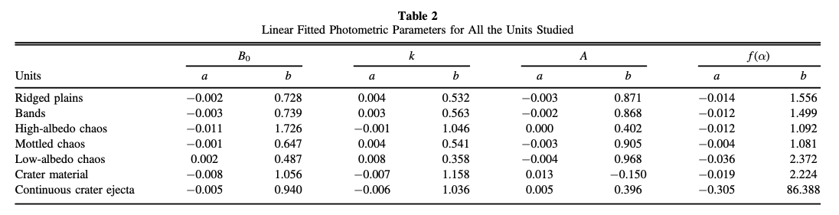
Linear Fits for Photometric Parameters of the Minnaert and Lommel-Seeliger + Lambert Models
Model fits based on 20 selected regions separated by geologic features

Slide 14
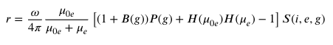
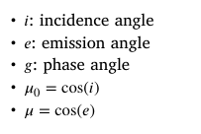
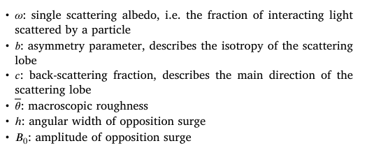
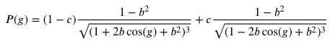
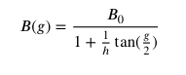
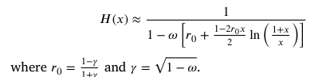
Hapke Model (Parameters fit from Belgacem et al. 2020)
A higher fidelity option that better captures photometric properties of Europa, but much more complicated
From Hapke et al chapter
on roughness, S is a very
complex function describing the macroscopic
roughness, not sure
whether the macroscopic
roughness parameter theta intended to be the
fit parameter to this value..
Paper fits values for omega, maybe
can use albedo map instead for finer
lat/lon coverage? Paper though mentions
a slight discrepancy between albedo from
map vs fit parameter which they suggest could be
a result of how the map was normalized contributing
to photometric errors

